Slide 1
SLOVENIAN TEAM

Slide 2
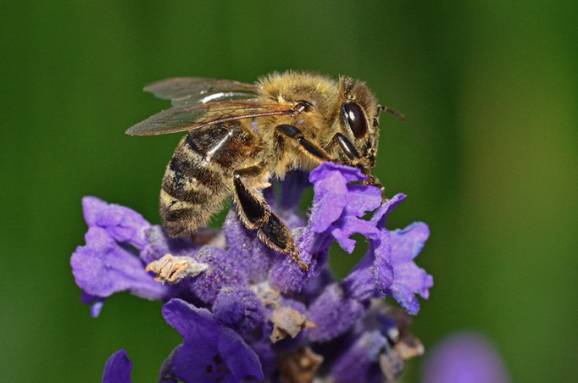
WHAT’S SO SPECIAL ABOUT BEEKEEPING IN SLOVENIA
NATIVE CARNIOLAN BEE here are approximately 20,000 bee species in the world, in Slovenia there are about 550
But one is unique – it is our NATIVE Carniolan honey bee (Apis mellifera carnica)
“Grey bee” because of their brownish-grey colour
Incredibly gentle and easy to work with and very productive in honey
Carniolan bee - second most common honeybee in the world
Source: https://www.beeourguest.eu/slovenia-beekeeping/

Slide 3
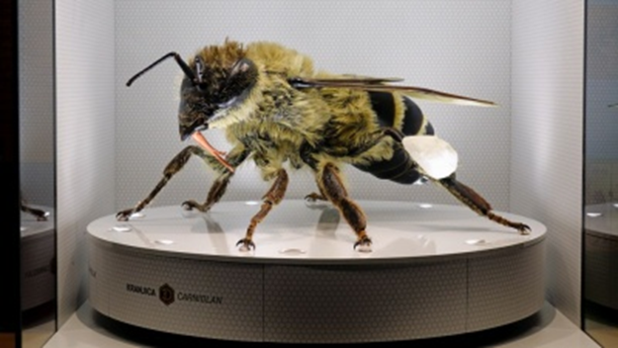
Slovenia is the only member of EU that has protected it´s native bee
May 20 - World Bee Day
Slovenia also runs a project: “The Guardians” – preserving and seleting the local population of the Carniolan bee
https://apis-mellifera-carnica.eu/en/advanced-selection-program-for-authentic-apis-mellifera-carnica/
Slovenia has the highest number of beekeepers per capital and because of that Slovenia also put on display a gigantic 3D model of the Carniolan honey bee in Slovenia's Expo pavilion in Dubai
Source: https://rralur.si/en/news/bee-friendly-region-at-expo-dubai/

Slide 4
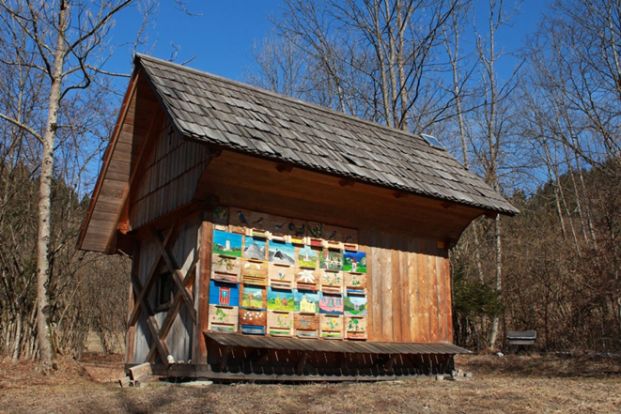
Painted beehive panels
Typically decorated with paintings depicting scenes and characters from folk tales
Helps bees find their way into beehives and makes it easier for the beekeeper to distinguish between bees colonies
Source: https://www.beeourguest.eu/slovenia-beekeeping/

Slide 5
Life in the forests
almost 60% of the surface covered in forests
the brown bear, the grey wolf, lynx, deer, roe deer, fox and wild boar
Slovenia boasts 400–500 brown bears – ranks among countries with the highest bear population in the world
Most are found in the Kočevsko forests, where you can also find the remains of virgin forests

Slide 6
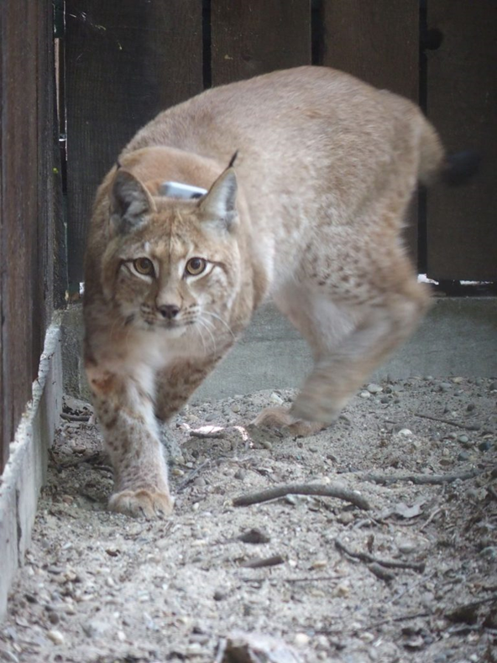
The bear, wolf and lynx have been protected by regulations on nature conservation since 1993
Lynx extinct in 20th century, then reintroduced in 1973
Current population – 15 to 20 animals
New lynx arrived from Romania in 2022
Source: https://www.lifelynx.eu/the-new-lynx-was-named-by-pupils-from-the-sodrazica-primary-school/

Slide 7
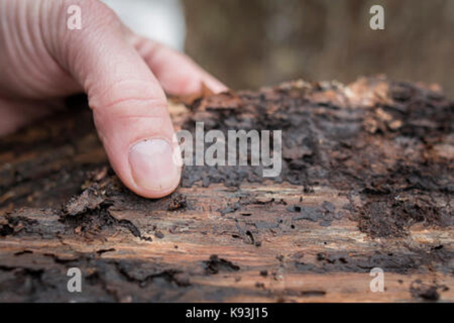
Slovenia faces natural disaster due to bark beetle
In the last decades – two large-scale outbreaks: drought and ice storm
Spreading of dark beetles – boosted by high temperatures in summer – weak trees and insect grow
Trees had to be cut down
Source: https://www.alamy.com/stock-image-stane-kunej-worker-of-slovenian-forestry-company-in-triglav-national-160505217.html

Slide 8
Authentic Slovenian breeds
White Lipizzaner, Cave salamander – Proteus, Carniolan honey bee, Soča trout, Golden Eagle, Brown Bear, Karst Shepherd dog, Slovenian sheep

Slide 9
Urban climate
Ljubljana – 293.000 population
2016 - Green Capital of Europe
Largest number of sustainable changes in the shortest period of time
2019 – Sustainable Top 100 Destination Awards

Slide 10
Now, what makes Ljubljana one of the most sustainable cities in the world?
the city has been traffic-free since 2008
electric-powered vehicle Kavalir runs around the historical city centre at a slow speed
BicikeLJ bike
Car sharing Avant2Go – electric

Slide 11
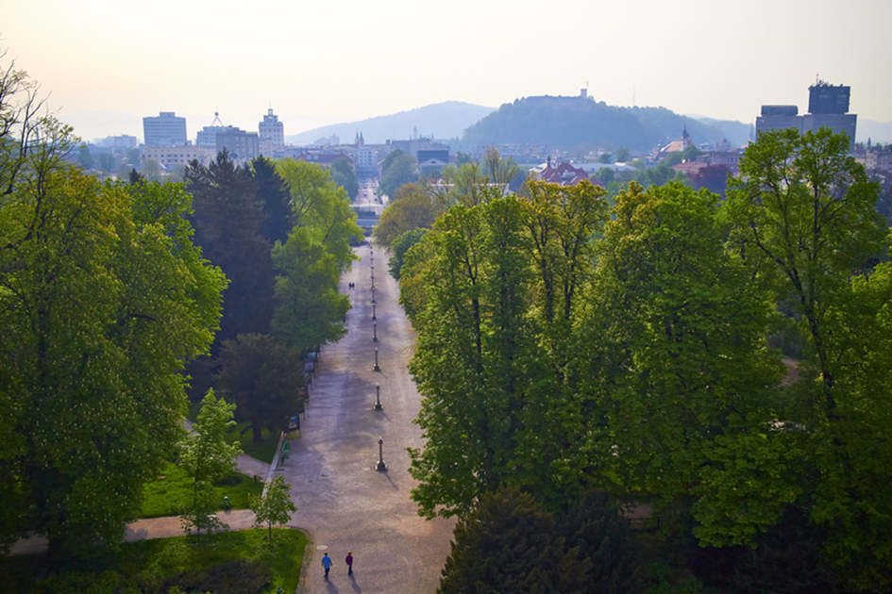
Offers a high quality of life
542 square meters of green space space per inhabitant and direct access to the city centre itself from countryside
Pollinator-friendly plants in parks
locally produced food - ‘from local field, to local table, to the guest’
Source: https://www.inyourpocket.com/ljubljana/Green-Capital-of-Europe

Slide 12
Organic Farming spreads in Slovenia
Slovenia: 2 milion inhabitants, 43.7% live in rural areas, 20.273 km², 56,1% forest areas 39,9% agricultural land – 10,4% of this is organic
Organic farms and growers and processors of organic food in Slovenia increases from year to year
Slovenia Green Cuisine – many restaurants have their own circle of local suppliers or even their own gardens or fields where they obtain the ingredients for their dishes
Source: https://www.slovenia.info/en/stories/restaurants-with-the-slovenia-green-sustainability-label

