Slide 1
9.MAJ DAN EVROPE
Tommorow is a special day – May 9
On 9 May, Europe celebrates the Victory Day. It is a holiday that commemorates the surrender of Nazi Germany in 1945 which marked the end of World War II in Europe.
On the same day Ljubljana, our capital, celebrates its most important holiday when all citizens commemorate the victory of the Partisan Army over the occupier in 1945.
May 9 is also »EUROPE DAY«. Every year it celebrates peace and unity in Europe. The date marks the anniversary of the historic 'Schuman declaration' that set out his idea for a new form of political cooperation in Europe, which would make war between Europe's nations unthinkable. Schuman's proposal is considered to be the beginning of what is now the European Union.
Shuman s plan was realized a year later, when the »Europpean Coal and Steel Community«, the forerunner of today s European Union, was established.
The European Union guarantees peace and security, strives for the well-being of all Europeans, believes in democracy, human rights, the rule of law and freedom of the media. It shows the diversity and coexistence of our national and other identities. We all celebrate May 9, Europe Day, as our common holiday. And we have never needed each other like we do now in this global context.

Slide 2
VICTORY DAY 9 of May 1945

Slide 5
EUROPE DAY
9 OF MAY

Slide 8
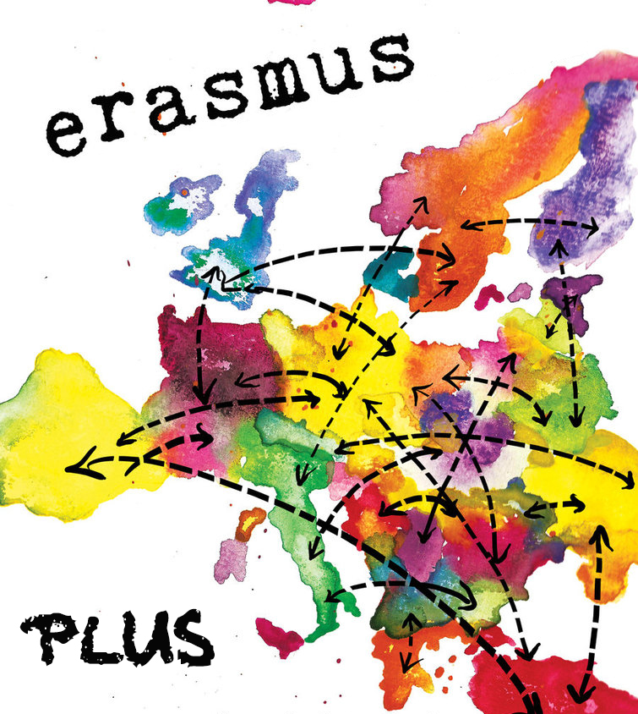

Slide 9
We are the world We are the children We are the ones who make a brighter day, so let's start giving There's a choice we're making We're saving our own lives It's true we'll make a better day, just you and me

